Slide 1
EENG 385 Audio Board Power Supply
Notes:
Usually the <title of the lab> is what will be called the “System” through the rest of this document

Slide 2
Lab Objectives
The objective of this lab is to study the components and design of a power supply including linear regulators, Zener diodes and reverse voltage protections and start you on the path to constructing the Audio board.

Slide 3
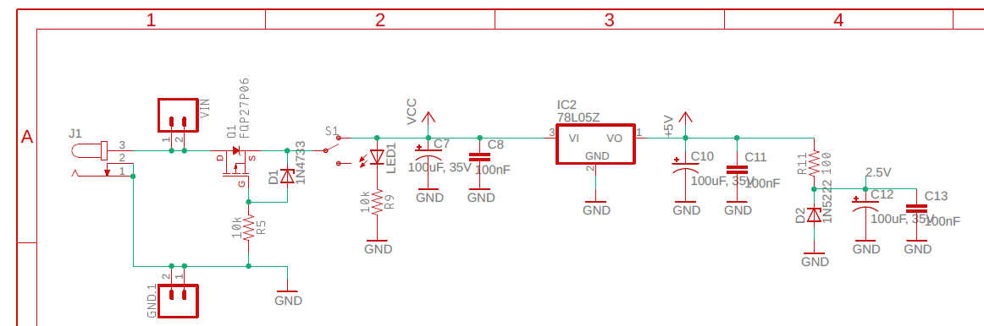
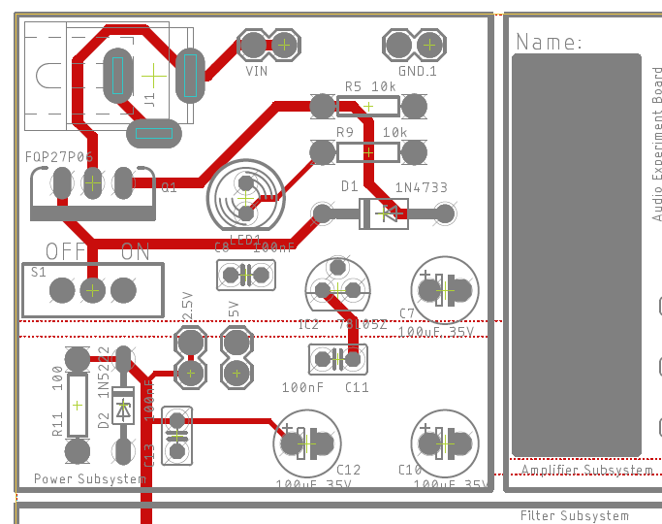
Power Supply Subsystem
Schematic Layout

Slide 4
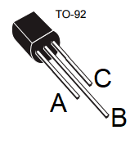
7805 Linear Regulator
Input voltage = 5V + dropout voltage
Output voltage = 5V
Dissipates excess voltage as heat P = ΔV * I
ΔV =Vin – 5V
I is current to load
Pmax around 1Watt
Notes:
Replace <System> with the name of the

Slide 5
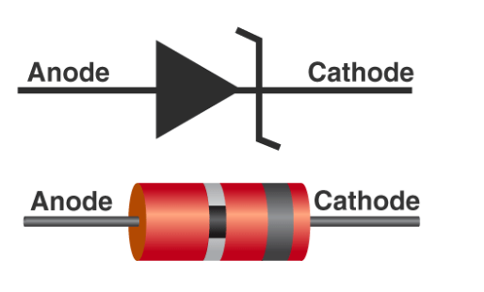
Zener Diode - 1N4733
Reverse biased
Clamps to 5.1V
Used to limit or regulate voltage
Forward biased
Clamps to 1.2V
Notes:
Replace <System> with the name of the

Slide 6
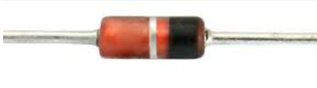
Zener Diode - 1N5222
Reverse biased
Clamps to 2.5V
Used to regulate voltage
Notes:
Replace <System> with the name of the

Slide 7
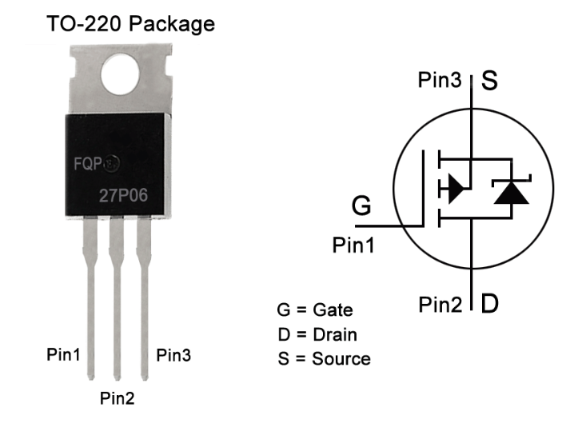
P-channel MOSFET - FQP27P06
V_{g} < V_{s}
Short circuit between S and D
V_{g} > V_{s}
Open circuit between S and D
Notes:
Replace <System> with the name of the

Slide 8
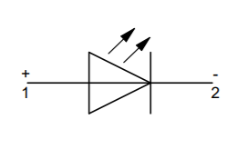
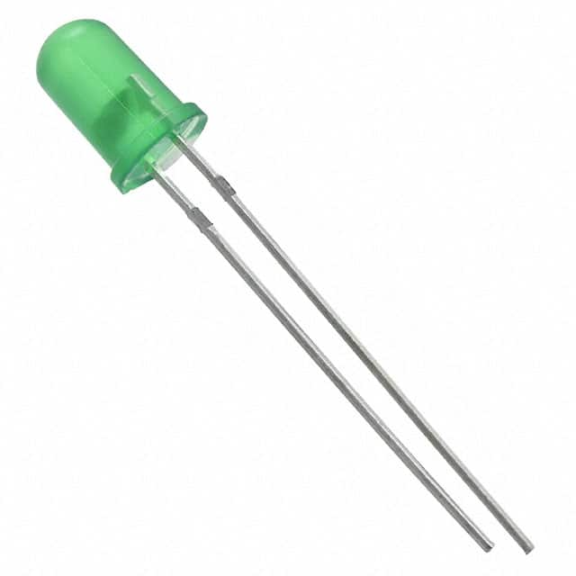
LED
The power-on LED provides positive confirmation that power is bring delivered to the circuit.
This is a “must-add” to any PCB you are designing
Notes:
Replace <System> with the name of the

Slide 9
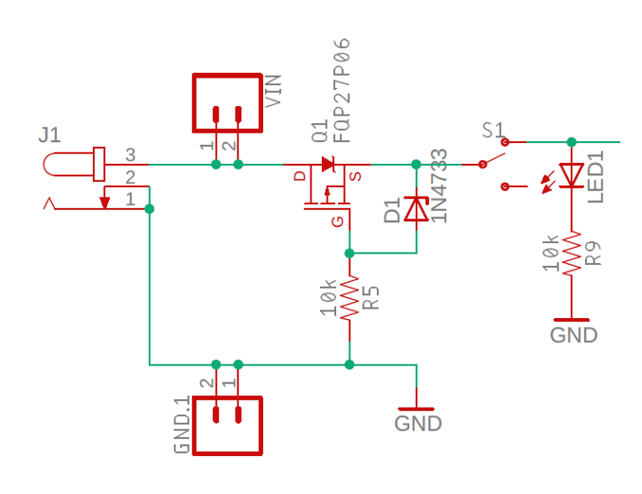
Theory
Reverse Voltage Protection
FQP27P06 acts like a switch
Open when V_{sg} < 3V
Closed when V_{sg} > 3V
1N4733 Zener diode
Limits V_{sg} of MOSFET to 5.1V
Forward biased V_{gs} =1.2V
Notes:
Replace <System> with the name of the

Slide 10
Turn In
Make a record of your response to numbered items below
LM7805 Questions 1 – 5
Zener Diode Questions 1 – 3
Power-on LED Questions 1 – 9
On/off switch Questions 1 – 2
Reverse Volt Questions 1-7
Solder only the power supply subsystem
Do not solder audio and filter components
Test voltage outputs with DMM
Sign your name on your PCB

